Slide 1
Discrete-Time Fourier Series
Lecture 28

Slide 2
DTFS (represented by N complex exponentials)

Slide 3
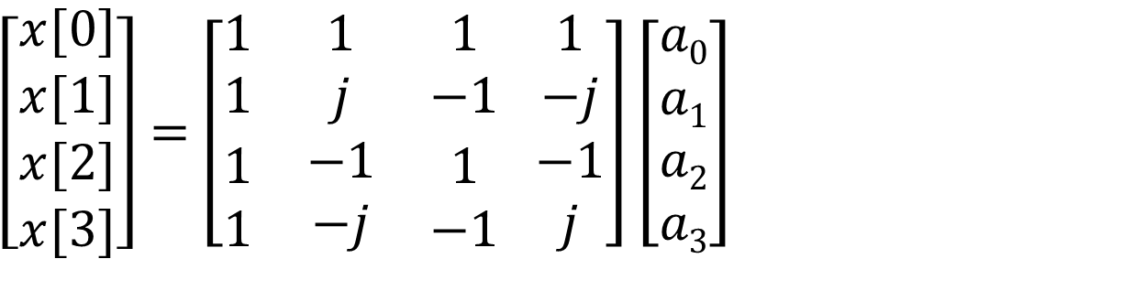
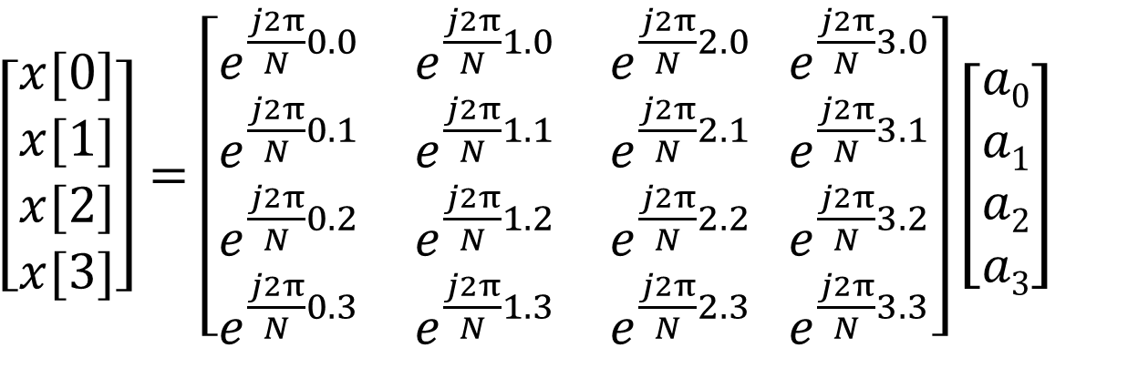
DTFS by Matrix
$\left[\begin{matrix}x[0] \\ x[1] \\ \begin{aligned}x[2] \\ x[3]\end{aligned}\end{matrix}\right]=$ $\left[\begin{matrix}e^{\frac{j2π}{N}0.0} & e^{\frac{j2π}{N}1.0} & e^{\frac{j2π}{N}2.0} \\ e^{\frac{j2π}{N}0.1} & e^{\frac{j2π}{N}1.1} & e^{\frac{j2π}{N}2.1} \\ \begin{aligned}e^{\frac{j2π}{N}0.2} \\ e^{\frac{j2π}{N}0.3}\end{aligned} & \begin{aligned}e^{\frac{j2π}{N}1.2} \\ e^{\frac{j2π}{N}1.3}\end{aligned} & \begin{aligned}e^{\frac{j2π}{N}2.2} \\ e^{\frac{j2π}{N}2.3}\end{aligned}\end{matrix} \begin{matrix}e^{\frac{j2π}{N}3.0} \\ e^{\frac{j2π}{N}3.1} \\ \begin{aligned}e^{\frac{j2π}{N}3.2} \\ e^{\frac{j2π}{N}3.3}\end{aligned}\end{matrix}\right]\left[\begin{aligned}a0 \\ a1 \\ a2 \\ a3\end{aligned}\right]$
$\left[\begin{matrix}x[0] \\ x[1] \\ \begin{aligned}x[2] \\ x[3]\end{aligned}\end{matrix}\right]=$ $\left[\begin{matrix}1 & 1 & 1 \\ 1 & j & −1 \\ \begin{aligned}1 \\ 1\end{aligned} & \begin{aligned}−1 \\ −j\end{aligned} & \begin{aligned}1 \\ −1\end{aligned}\end{matrix} \begin{matrix}1 \\ −j \\ \begin{aligned}−1 \\ j\end{aligned}\end{matrix}\right]\left[\begin{aligned}a0 \\ a1 \\ a2 \\ a3\end{aligned}\right]$

Slide 4
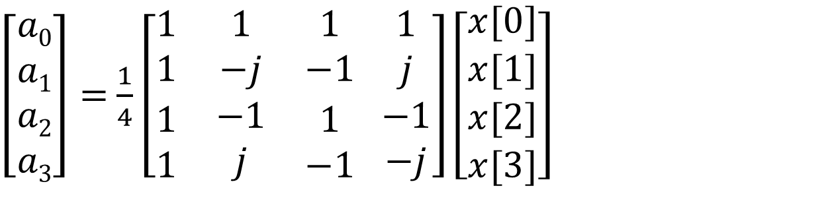
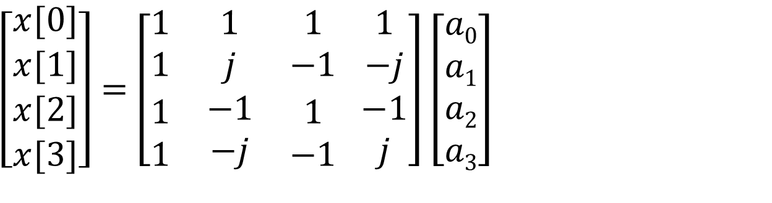
DTFS by Matrix
$\left[\begin{matrix}x[0] \\ x[1] \\ \begin{aligned}x[2] \\ x[3]\end{aligned}\end{matrix}\right]=$ $\left[\begin{matrix}1 & 1 & 1 \\ 1 & j & −1 \\ \begin{aligned}1 \\ 1\end{aligned} & \begin{aligned}−1 \\ −j\end{aligned} & \begin{aligned}1 \\ −1\end{aligned}\end{matrix} \begin{matrix}1 \\ −j \\ \begin{aligned}−1 \\ j\end{aligned}\end{matrix}\right]\left[\begin{aligned}a0 \\ a1 \\ a2 \\ a3\end{aligned}\right]$
Matrices are inverse of each other
$\left[\begin{aligned}a0 \\ a1 \\ a2 \\ a3\end{aligned}\right]=$ $\frac{1}{4}\left[\begin{matrix}1 & 1 & 1 \\ 1 & −j & −1 \\ \begin{aligned}1 \\ 1\end{aligned} & \begin{aligned}−1 \\ j\end{aligned} & \begin{aligned}1 \\ −1\end{aligned}\end{matrix} \begin{matrix}1 \\ j \\ \begin{aligned}−1 \\ −j\end{aligned}\end{matrix}\right]\left[\begin{matrix}x[0] \\ x[1] \\ \begin{aligned}x[2] \\ x[3]\end{aligned}\end{matrix}\right]$
Number of operations increases as N²

Slide 5
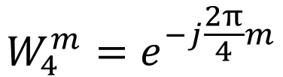
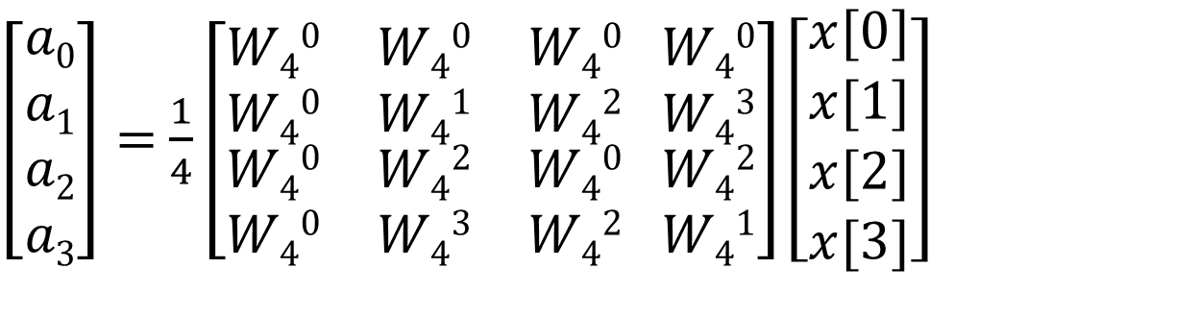
Fast Fourier “Transform”
Divide FS of length 2N into two of length N (divide and conquer)
$\left[\begin{aligned}a0 \\ a1 \\ a2 \\ a3\end{aligned}\right]=$ $\frac{1}{4}\left[\begin{matrix}W40 & W40 & W40 \\ W40 & W41 & W42 \\ \begin{aligned}W40 \\ W40\end{aligned} & \begin{aligned}W42 \\ W43\end{aligned} & \begin{aligned}W40 \\ W42\end{aligned}\end{matrix} \begin{matrix}W40 \\ W43 \\ \begin{aligned}W42 \\ W41\end{aligned}\end{matrix}\right]\left[\begin{matrix}x[0] \\ x[1] \\ \begin{aligned}x[2] \\ x[3]\end{aligned}\end{matrix}\right]$
$$W_{4}^{m}=e^{−j\frac{2π}{4}m}$$
where
Number of Multiplications = 16
Number of Additions = 4×3=12
Total=28

Slide 6
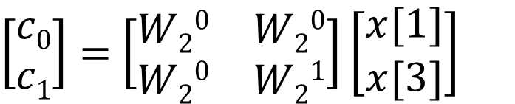
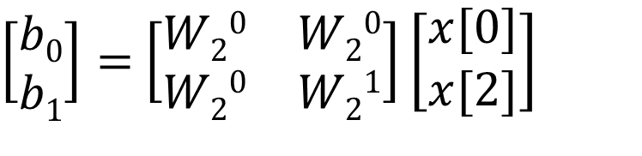
Fast Fourier Transform
Divide it into two 2-point series (divide and conquer)
Even-numbered entries in x[n]:
$\left[\begin{aligned}b0 \\ b1\end{aligned}\right]=$ $\left[\begin{matrix}W20 & W20 \\ W20 & W21\end{matrix}\right]\left[\begin{aligned}x[0] \\ x[2]\end{aligned}\right]$
Odd-numbered entries in x[n]:
$\left[\begin{aligned}c0 \\ c1\end{aligned}\right]=$ $\left[\begin{matrix}W20 & W20 \\ W20 & W21\end{matrix}\right]\left[\begin{aligned}x[1] \\ x[3]\end{aligned}\right]$
Number of Multiplications = 2×4
Number of Additions = 2×2=4
Total=12

Slide 7
Fast Fourier Transform
Break the original 4-point DTFS coefficients a_{k} into two parts:
a_{k}=d_{k}+e_{k}
where d_{k} comes from the even-numbered x[n] and e_{k} comes form the odd-numbered x[n]

Slide 8
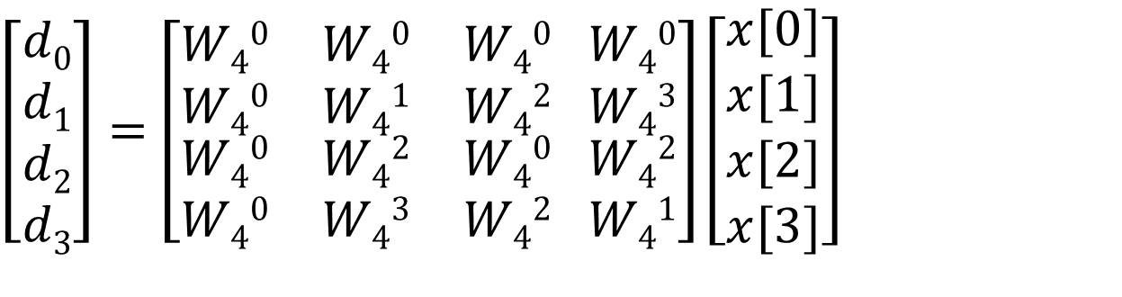
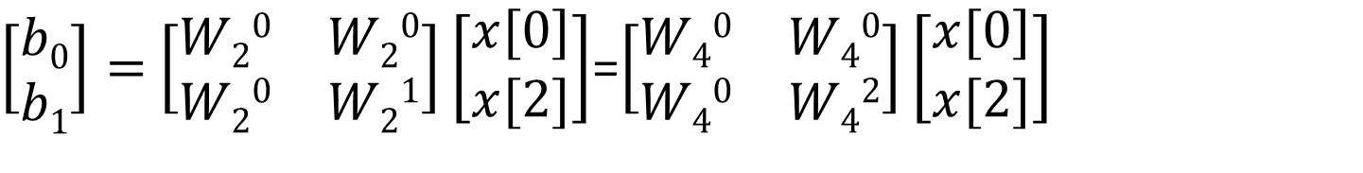
Fast Fourier Transform
The 2-point DTFS coefficients b_{k} of the even-numbered x[n]
$\left[\begin{aligned}b0 \\ b1\end{aligned}\right]=$ $\left[\begin{matrix}W20 & W20 \\ W20 & W21\end{matrix}\right]\left[\begin{aligned}x[0] \\ x[2]\end{aligned}\right]$=$\left[\begin{matrix}W40 & W40 \\ W40 & W42\end{matrix}\right]\left[\begin{aligned}x[0] \\ x[2]\end{aligned}\right]$
$\left[\begin{aligned}d0 \\ d1 \\ d2 \\ d3\end{aligned}\right]=$ $\left[\begin{matrix}W40 & W40 & W40 \\ W40 & W41 & W42 \\ \begin{aligned}W40 \\ W40\end{aligned} & \begin{aligned}W42 \\ W43\end{aligned} & \begin{aligned}W40 \\ W42\end{aligned}\end{matrix} \begin{matrix}W40 \\ W43 \\ \begin{aligned}W42 \\ W41\end{aligned}\end{matrix}\right]\left[\begin{matrix}x[0] \\ x[1] \\ \begin{aligned}x[2] \\ x[3]\end{aligned}\end{matrix}\right]$

Slide 9
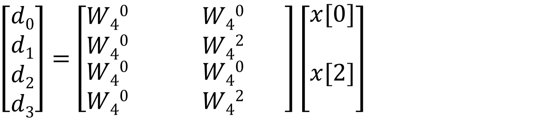
Fast Fourier Transform
The 2-point DTFS coefficients b_{k} of the even-numbered x[n]
$\left[\begin{aligned}b0 \\ b1\end{aligned}\right]=$ $\left[\begin{matrix}W20 & W20 \\ W20 & W21\end{matrix}\right]\left[\begin{aligned}x[0] \\ x[2]\end{aligned}\right]$=$\left[\begin{matrix}W40 & W40 \\ W40 & W42\end{matrix}\right]\left[\begin{aligned}x[0] \\ x[2]\end{aligned}\right]$
$\left[\begin{aligned}d0 \\ d1 \\ d2 \\ d3\end{aligned}\right]=$ $\left[\begin{matrix}W40 & & W40 \\ W40 & & W42 \\ \begin{aligned}W40 \\ W40\end{aligned} & \begin{aligned} \\ \end{aligned} & \begin{aligned}W40 \\ W42\end{aligned}\end{matrix} \begin{matrix} \\ \\ \begin{aligned} \\ \end{aligned}\end{matrix}\right]\left[\begin{matrix}x[0] \\ \\ \begin{aligned}x[2] \\ \end{aligned}\end{matrix}\right]$

Slide 10
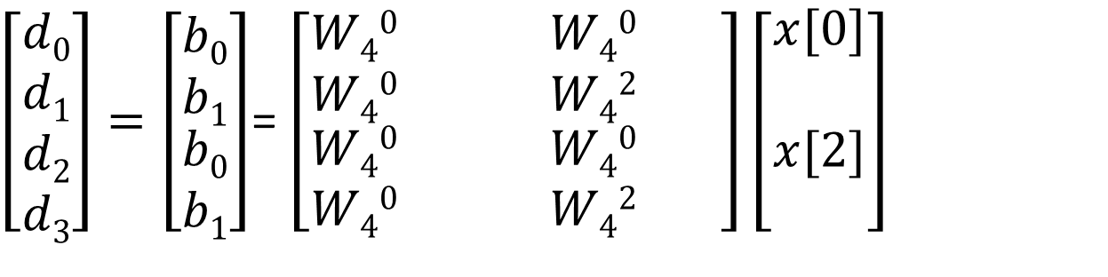
Fast Fourier Transform
The 2-point DTFS coefficients b_{k} of the even-numbered x[n]
$\left[\begin{aligned}b0 \\ b1\end{aligned}\right]=$ $\left[\begin{matrix}W20 & W20 \\ W20 & W21\end{matrix}\right]\left[\begin{aligned}x[0] \\ x[2]\end{aligned}\right]$=$\left[\begin{matrix}W40 & W40 \\ W40 & W42\end{matrix}\right]\left[\begin{aligned}x[0] \\ x[2]\end{aligned}\right]$
$\left[\begin{aligned}d0 \\ d1 \\ d2 \\ d3\end{aligned}\right]=\left[\begin{matrix}b0 \\ b1 \\ \begin{aligned}b0 \\ b1\end{aligned}\end{matrix}\right]$= $\left[\begin{matrix}W40 & & W40 \\ W40 & & W42 \\ \begin{aligned}W40 \\ W40\end{aligned} & \begin{aligned} \\ \end{aligned} & \begin{aligned}W40 \\ W42\end{aligned}\end{matrix} \begin{matrix} \\ \\ \begin{aligned} \\ \end{aligned}\end{matrix}\right]\left[\begin{matrix}x[0] \\ \\ \begin{aligned}x[2] \\ \end{aligned}\end{matrix}\right]$

Slide 11
Fast Fourier Transform
The 2-point DTFS coefficients b_{k} of the even-numbered x[n]
$\left[\begin{aligned}b0 \\ b1\end{aligned}\right]=$ $\left[\begin{matrix}W20 & W20 \\ W20 & W21\end{matrix}\right]\left[\begin{aligned}x[0] \\ x[2]\end{aligned}\right]$=$\left[\begin{matrix}W40 & W40 \\ W40 & W42\end{matrix}\right]\left[\begin{aligned}x[0] \\ x[2]\end{aligned}\right]$
$\left[\begin{aligned}d0 \\ d1 \\ d2 \\ d3\end{aligned}\right]=\left[\begin{matrix}b0 \\ b1 \\ \begin{aligned}b0 \\ b1\end{aligned}\end{matrix}\right]$= $\left[\begin{matrix}W40 & & W40 \\ W40 & & W42 \\ \begin{aligned}W40 \\ W40\end{aligned} & \begin{aligned} \\ \end{aligned} & \begin{aligned}W40 \\ W42\end{aligned}\end{matrix} \begin{matrix} \\ \\ \begin{aligned} \\ \end{aligned}\end{matrix}\right]\left[\begin{matrix}x[0] \\ \\ \begin{aligned}x[2] \\ \end{aligned}\end{matrix}\right]$

Slide 12
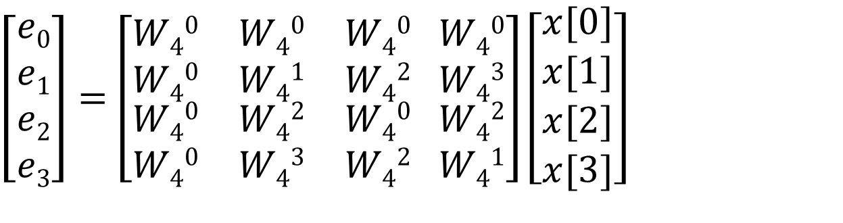
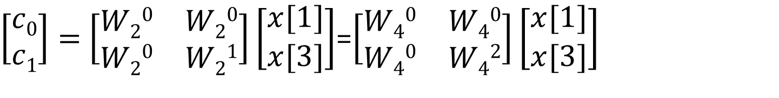
Fast Fourier Transform
The 2-point DTFS coefficients c_{k} of the odd-numbered x[n]
$\left[\begin{aligned}c0 \\ c1\end{aligned}\right]=$ $\left[\begin{matrix}W20 & W20 \\ W20 & W21\end{matrix}\right]\left[\begin{aligned}x[1] \\ x[3]\end{aligned}\right]$=$\left[\begin{matrix}W40 & W40 \\ W40 & W42\end{matrix}\right]\left[\begin{aligned}x[1] \\ x[3]\end{aligned}\right]$
$\left[\begin{aligned}e0 \\ e1 \\ e2 \\ e3\end{aligned}\right]=$ $\left[\begin{matrix}W40 & W40 & W40 \\ W40 & W41 & W42 \\ \begin{aligned}W40 \\ W40\end{aligned} & \begin{aligned}W42 \\ W43\end{aligned} & \begin{aligned}W40 \\ W42\end{aligned}\end{matrix} \begin{matrix}W40 \\ W43 \\ \begin{aligned}W42 \\ W41\end{aligned}\end{matrix}\right]\left[\begin{matrix}x[0] \\ x[1] \\ \begin{aligned}x[2] \\ x[3]\end{aligned}\end{matrix}\right]$

Slide 13
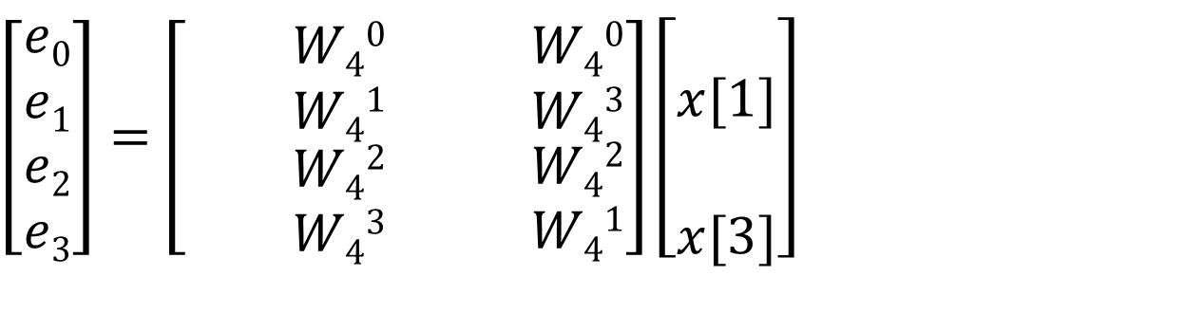
Fast Fourier Transform
The 2-point DTFS coefficients c_{k} of the odd-numbered x[n]
$\left[\begin{aligned}c0 \\ c1\end{aligned}\right]=$ $\left[\begin{matrix}W20 & W20 \\ W20 & W21\end{matrix}\right]\left[\begin{aligned}x[1] \\ x[3]\end{aligned}\right]$=$\left[\begin{matrix}W40 & W40 \\ W40 & W42\end{matrix}\right]\left[\begin{aligned}x[1] \\ x[3]\end{aligned}\right]$
$\left[\begin{aligned}e0 \\ e1 \\ e2 \\ e3\end{aligned}\right]=$ $\left[\begin{matrix} & W40 & \\ & W41 & \\ \begin{aligned} \\ \end{aligned} & \begin{aligned}W42 \\ W43\end{aligned} & \begin{aligned} \\ \end{aligned}\end{matrix} \begin{matrix}W40 \\ W43 \\ \begin{aligned}W42 \\ W41\end{aligned}\end{matrix}\right]\left[\begin{matrix} \\ x[1] \\ \begin{aligned} \\ x[3]\end{aligned}\end{matrix}\right]$

Slide 14
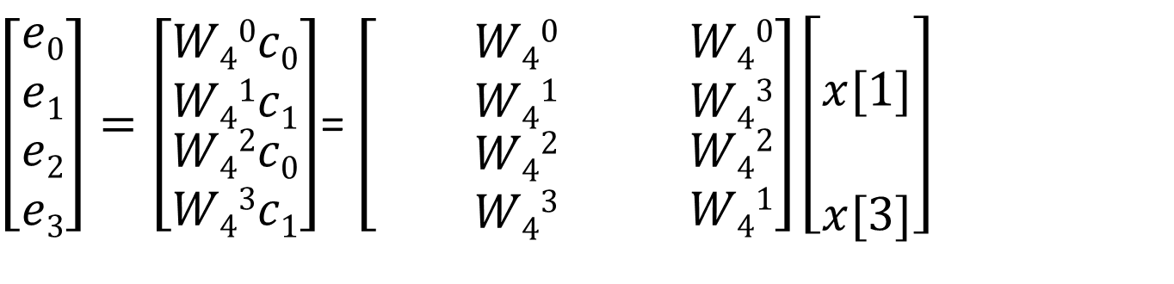
Fast Fourier Transform
The 2-point DTFS coefficients c_{k} of the odd-numbered x[n]
$\left[\begin{aligned}c0 \\ c1\end{aligned}\right]=$ $\left[\begin{matrix}W20 & W20 \\ W20 & W21\end{matrix}\right]\left[\begin{aligned}x[1] \\ x[3]\end{aligned}\right]$=$\left[\begin{matrix}W40 & W40 \\ W40 & W42\end{matrix}\right]\left[\begin{aligned}x[1] \\ x[3]\end{aligned}\right]$
$\left[\begin{aligned}e0 \\ e1 \\ e2 \\ e3\end{aligned}\right]=\left[\begin{matrix}W40c0 \\ W41c1 \\ \begin{aligned}W42c0 \\ W43c1\end{aligned}\end{matrix}\right]$= $\left[\begin{matrix} & W40 & \\ & W41 & \\ \begin{aligned} \\ \end{aligned} & \begin{aligned}W42 \\ W43\end{aligned} & \begin{aligned} \\ \end{aligned}\end{matrix} \begin{matrix}W40 \\ W43 \\ \begin{aligned}W42 \\ W41\end{aligned}\end{matrix}\right]\left[\begin{matrix} \\ x[1] \\ \begin{aligned} \\ x[3]\end{aligned}\end{matrix}\right]$

Slide 15
Fast Fourier Transform
The 2-point DTFS coefficients c_{k} of the odd-numbered x[n]
$\left[\begin{aligned}c0 \\ c1\end{aligned}\right]=$ $\left[\begin{matrix}W20 & W20 \\ W20 & W21\end{matrix}\right]\left[\begin{aligned}x[1] \\ x[3]\end{aligned}\right]$=$\left[\begin{matrix}W40 & W40 \\ W40 & W42\end{matrix}\right]\left[\begin{aligned}x[1] \\ x[3]\end{aligned}\right]$
$\left[\begin{aligned}e0 \\ e1 \\ e2 \\ e3\end{aligned}\right]=\left[\begin{matrix}W40c0 \\ W41c1 \\ \begin{aligned}W42c0 \\ W43c1\end{aligned}\end{matrix}\right]$= $\left[\begin{matrix} & W40 & \\ & W41 & \\ \begin{aligned} \\ \end{aligned} & \begin{aligned}W42 \\ W43\end{aligned} & \begin{aligned} \\ \end{aligned}\end{matrix} \begin{matrix}W40 \\ W43 \\ \begin{aligned}W42 \\ W41\end{aligned}\end{matrix}\right]\left[\begin{matrix} \\ x[1] \\ \begin{aligned} \\ x[3]\end{aligned}\end{matrix}\right]$

Slide 16

Fast Fourier Transform
Combine d_{k} and e_{k} to get a_{k}
$$\left[\begin{aligned}a0 \\ a1 \\ a2 \\ a3\end{aligned}\right]=\left[\begin{aligned}d0+e0 \\ d1+e1 \\ d2+e2 \\ d3+e3\end{aligned}\right]=\left[\begin{matrix}b0 \\ b1 \\ \begin{aligned}b0 \\ b1\end{aligned}\end{matrix}\right]+\left[\begin{matrix}W40c0 \\ W41c1 \\ \begin{aligned}W42c0 \\ W43c1\end{aligned}\end{matrix}\right]$$
FFT procedure:
Compute b_{k} and c_{k}: 2×(2×2) = 8 multiples
Combine a_{k}=b_{k}+W₄^{k}c_{k}: 4 multiples
Total 12 multiples: fewer than the original 16 multiples
Total 8 additions: fewer than the original 12 additions

Slide 17
Scaling of the FFT algorithm
Let M(n) be the number of multiples to compute n-point FFT
N = 1024
  Original = 1048576
  FFT = 10240
  ONE MILLION OPERATIONS REDUCES TO TEN THOUSAND

Slide 18
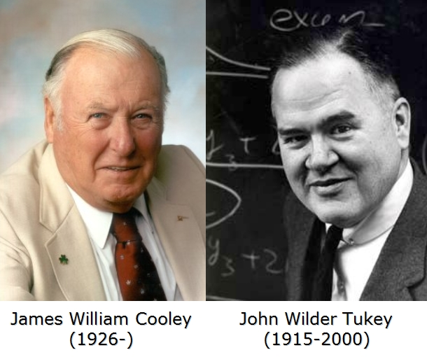
Cooley and Tukey
James Cooley and John Tukey were research scientists at IBM.
They published their work in 1965 (read it on Google).
He developed fast Fourier transforms to understand the data from sensors which were planted to detect nuclear explosions.

Slide 19

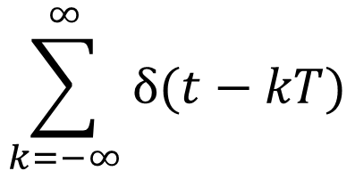
Picket Fence
$$\sum_{k=−∞}^{∞}{δ(t−kT)}$$
$$T$$

Slide 20


Picket Fence
$$\sum_{k=−∞}^{∞}{δ(t−kT)}$$
$$T$$
$$1/T$$
Line Spectrum
$$2π/T$$

Slide 21

Picket Fence
$$\sum_{k=−∞}^{∞}{δ(t−kT)}$$
$$T$$
$$2π/T$$
Fourier Spectrum
$$2π/T$$

Slide 22
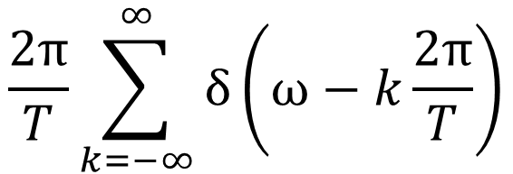
Picket Fence
$$\sum_{k=−∞}^{∞}{δ(t−kT)}$$
$$T$$
$$2π/T$$
$$\frac{2π}{T}\sum_{k=−∞}^{∞}{δ\left(ω−k\frac{2π}{T}\right)}$$
$$2π/T$$

Slide 23
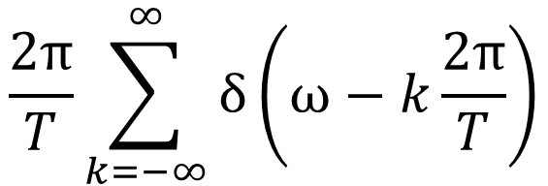
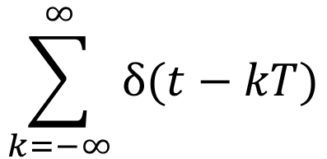

Picket Fence
$$\sum_{k=−∞}^{∞}{δ(t−kT)}$$
$$\frac{2π}{T}\sum_{k=−∞}^{∞}{δ\left(ω−k\frac{2π}{T}\right)}$$
$$𝔽$$
Picket Fence
Picket Fence

Slide 24
Relations between Fourier Transforms
CTFT

Slide 25
Relations between Fourier Transforms
CTFT
CTFS
Periodic extension

Slide 26
Periodic extension
1

Slide 27



Periodic extension
$$1$$
1
$$∗$$
$$T$$

Slide 28

Periodic extension
$$1$$
1
$$∗$$
$$1$$
$$T$$

Slide 29
Periodic extension
$$1$$
1
$$∗$$
$$T$$

Slide 30



Periodic extension
$$1$$
$$∗$$
$$T$$
$$2π/T$$
$$×$$
$$=$$
$$2π/T$$

Slide 31
Relations between Fourier Transforms
CTFT
CTFS
Periodic extension

Slide 32

Relations between Fourier Transforms
$$T→∞$$
CTFT
CTFS
Periodic extension

Slide 33
Relations between Fourier Transforms
$$T→∞$$
CTFT
CTFS
Periodic extension
DTFT

Slide 34
Relations between Fourier Transforms
$$T→∞$$
CTFT
CTFS
Periodic extension
Sampling
Interpolation
DTFT

Slide 35



Sampling
$$1$$
$$×$$
$$=$$
$$T$$

Slide 36


Sampling
$$1$$
$$×$$
$$=$$
$$T$$
$$2π/T$$
$$∗$$
$$2π/T$$

Slide 37


Sampling
$$1$$
$$×$$
$$=$$
$$T$$
$$𝔽$$
$$1/T$$
$$2π/T$$

Slide 38
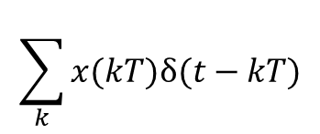


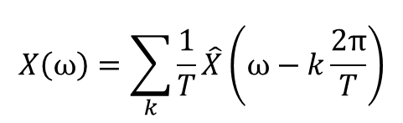


Sampling
$$\sum_{k}{x(kT)δ(t−kT)}$$
$$x(t)$$
$$x\left[n\right]=x(nT)$$
$$\hat{X}(ω)$$
$$X\left(ω\right)=\sum_{k}{\frac{1}{T}\hat{X}\left(ω−k\frac{2π}{T}\right)}$$
$$X\left(e^{jΩ}\right)$$

Slide 39
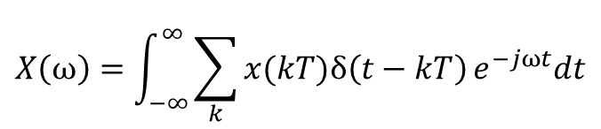
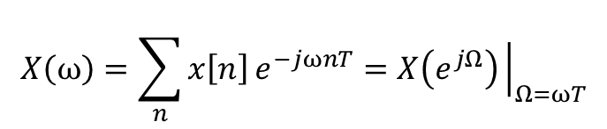
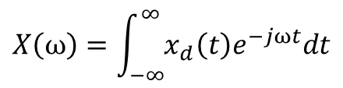
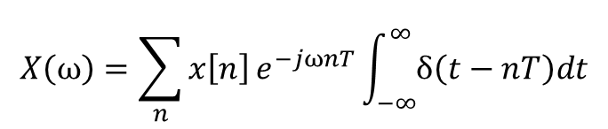
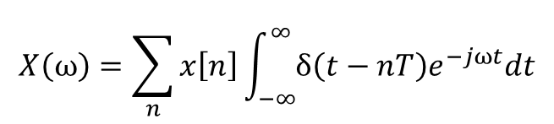
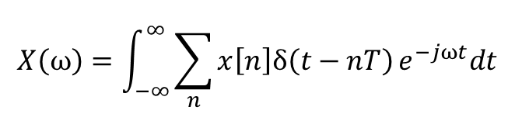
Relationship between Fourier Transforms
$$X\left(ω\right)=\sum_{n}{x\left[n\right]}e^{−jωnT}\int_{−∞}^{∞}{δ\left(t−nT\right)dt}$$
$$X\left(ω\right)=\int_{−∞}^{∞}{x_{d}\left(t\right)e^{−jωt}dt}$$
$$X\left(ω\right)=\int_{−∞}^{∞}{\sum_{k}{x(kT)δ\left(t−kT\right)}e^{−jωt}dt}$$
$$X\left(ω\right)=\sum_{n}{x\left[n\right]}e^{−jωnT}=X\left(e^{jΩ}\right){\left.​\right|}_{Ω=ωT}$$
$$X\left(ω\right)=\int_{−∞}^{∞}{\sum_{n}{x\left[n\right]δ\left(t−nT\right)}e^{−jωt}dt}$$
$$X\left(ω\right)=\sum_{n}{x\left[n\right]}\int_{−∞}^{∞}{δ\left(t−nT\right)e^{−jωt}dt}$$

Slide 41














Relationship between Fourier Transforms
$$X\left(ω\right)$$
$$𝔽$$
$$1/T$$
$$\frac{4π}{T}$$
$$\frac{6π}{T}$$
$$ω$$
$$0$$
$$\frac{2π}{T}$$
$$X\left(e^{jΩ}\right)$$
$$𝔽$$
$$1/T$$
$$4π$$
$$6π$$
$$Ω$$
$$0$$
$$2π$$

Slide 42

Relations between Fourier Transforms
$$T→∞$$
CTFT
CTFS
Periodic extension
Sampling
Sampling
Interpolation
Interpolation
DTFT
$$N→∞$$
DTFS
Periodic extension

Slide 43









Relationship between Fourier Transforms
$$X\left(e^{jΩ}\right)$$
$$𝔽$$
$$1/T$$
$$4π$$
$$Ω$$
$$0$$
$$2π$$
$$X\left(e^{jΩ}\right)$$
$$𝔽$$
$$1/T$$
$$4π$$
$$Ω$$
$$0$$
$$2π$$

Slide 44
Summary
DFT is most useful
FFT is the most used computer algorithm

